Slide 1



TUBES PBO

Slide 2



rebah.an tech (RA-10)
KELOMPOK 10 PBO RA

Slide 3


Anggota Kelompok
LEADER:
Ahmad Fadillah
120140092
Anisa Prasetya
120140087
Rahman Pajri
120140118
William Rusli
120140090
Alfian Kafilah
120140109
M. Fikri Damar
120140077

Slide 4





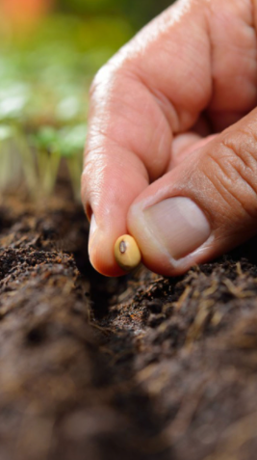






MORPHLING
rebah.an tech
Kelompok PBO10-RA
baru
fruits
seed
soya
tree
lama
rapper
bunga

Slide 5
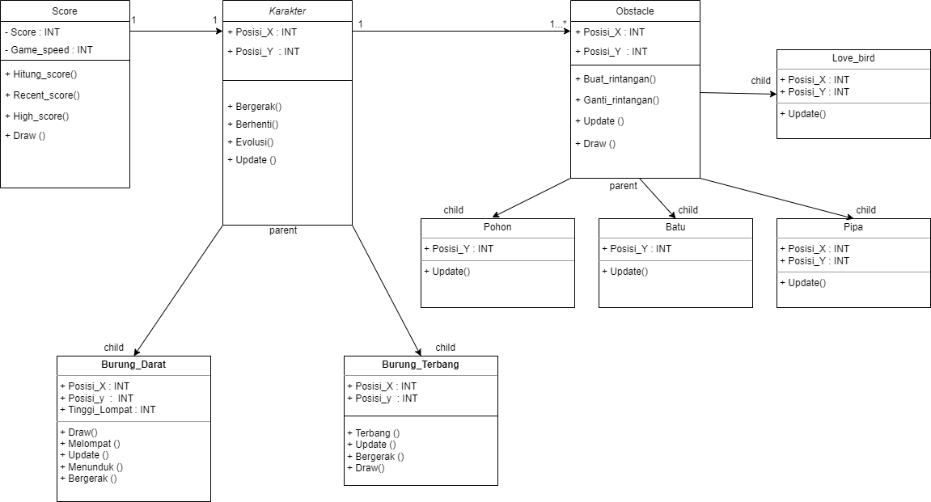

FOREST
07
design by hmpt
Desain UML Class Diagram
rebah.an tech
Kelompok PBO10-RA
about seed
A seed is an embryonic plant enclosed in a protective outer covering. The formation of the seed is part of the process of reproduction in seed plants, the spermatophytes, including the gymnosperm and angiosperm plants.
Seeds are the product of the ripened ovule, after fertilization by pollen and some growth within the mother plant. The embryo develops from the zygote, and the seed coat from the integuments of the ovule.
design by hmpt

Slide 6
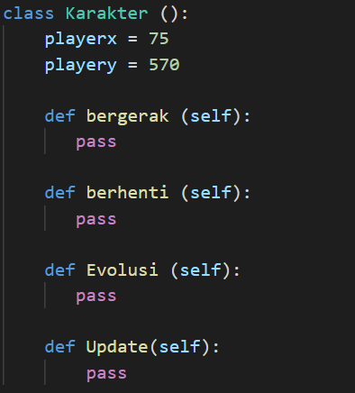
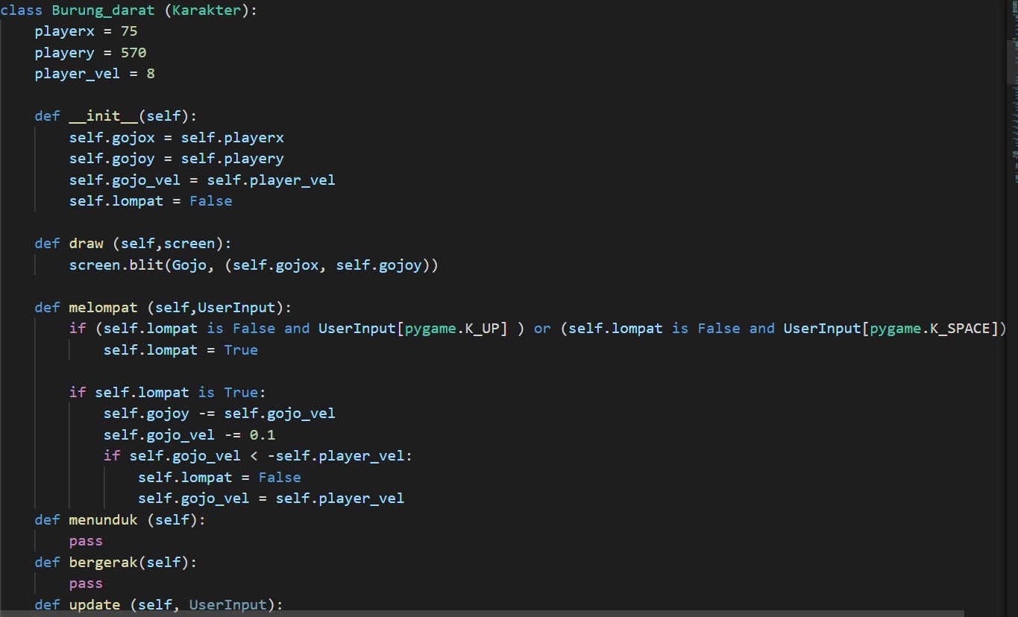
FOREST
07
design by hmpt
Implementasi Kelas
rebah.an tech
Kelompok PBO10-RA
about seed
A seed is an embryonic plant enclosed in a protective outer covering. The formation of the seed is part of the process of reproduction in seed plants, the spermatophytes, including the gymnosperm and angiosperm plants.
Seeds are the product of the ripened ovule, after fertilization by pollen and some growth within the mother plant. The embryo develops from the zygote, and the seed coat from the integuments of the ovule.
design by hmpt

Slide 7
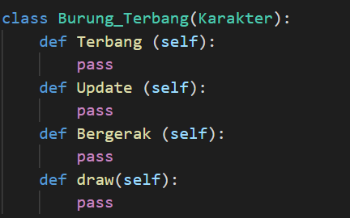
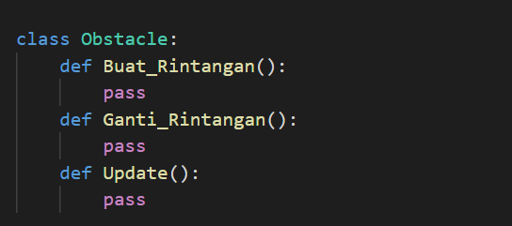

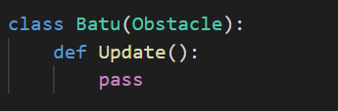
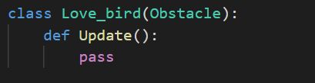

FOREST
07
design by hmpt
Implementasi Kelas
rebah.an tech
Kelompok PBO10-RA
about seed
A seed is an embryonic plant enclosed in a protective outer covering. The formation of the seed is part of the process of reproduction in seed plants, the spermatophytes, including the gymnosperm and angiosperm plants.
Seeds are the product of the ripened ovule, after fertilization by pollen and some growth within the mother plant. The embryo develops from the zygote, and the seed coat from the integuments of the ovule.
design by hmpt

Slide 8
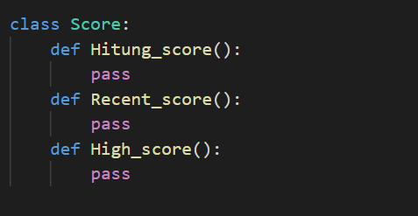
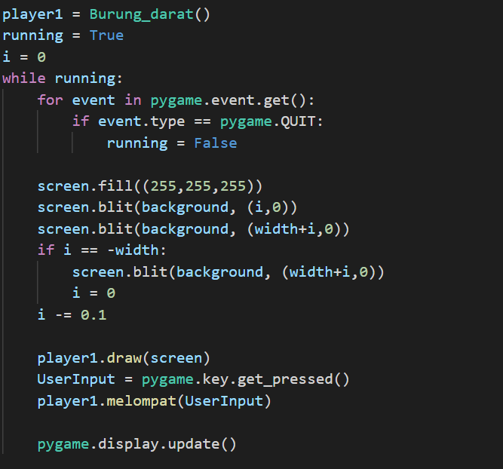
FOREST
07
design by hmpt
Implementasi Kelas
Untuk lebih jelas dalam memahami source code tersebut, berikut kami cantumkan link github :
https://github.com/AhmadFadillah12/Rebah.an-tech
rebah.an tech
Kelompok PBO10-RA
about seed
A seed is an embryonic plant enclosed in a protective outer covering. The formation of the seed is part of the process of reproduction in seed plants, the spermatophytes, including the gymnosperm and angiosperm plants.
Seeds are the product of the ripened ovule, after fertilization by pollen and some growth within the mother plant. The embryo develops from the zygote, and the seed coat from the integuments of the ovule.
design by hmpt

Slide 9
FOREST
07
design by hmpt
Kesimpulan
Dari design uml class dan potongan source code yang telah dipresentasikan mengenai game MORPHLING, kami memahami serta menerapkan 4 pilar utama dalam Pemrograman Berioerintasi Objek yaitu inheritance, abstraksi, enkapsulasi dan polymorphisme. Kelompok kami berusaha menerapkan konsep tersebut dengan harapan akan membuat programmer lain memahami 4 konsep utama Pemrograman Berorientasi Objek ketika memainkan game MORPHLING yang akan dibuat.
rebah.an tech
Kelompok PBO10-RA
about seed
A seed is an embryonic plant enclosed in a protective outer covering. The formation of the seed is part of the process of reproduction in seed plants, the spermatophytes, including the gymnosperm and angiosperm plants.
Seeds are the product of the ripened ovule, after fertilization by pollen and some growth within the mother plant. The embryo develops from the zygote, and the seed coat from the integuments of the ovule.
design by hmpt

Slide 10

morphling
rebah.an tech
Kelompok PBO 10-RA

Slide 11
Kasih
Terima
Morphling

